Slide 1

Salary Prediction
- Jasmine Jalaludin Chunara

Slide 2

Objective:
The objective of the model is to predict the salaries of the employees with regards to :-
- Their work designation title,
Number of years of work experience,
Company,
And its location.

Slide 3
Dataset:
Dataset consists of 62000 salary records of employees with different designations at varied companies and locations depending on the number of years of work experience.
There are 29 columns in the dataset, namely,
TimeStamp, Company, Level, Title, Total Yearly Compensation, Location, Years of Experience, Years at Company, Tag, Base Salary, Stock Grant Value, Bonus, Gender, Other details, City ID, Dmaid, RowNumber, Master’s Degree, Bachelor’s Degree, Doctoral Degree, High School, Some_college, Race_Asian, Race_White, Race_two_or_more, Race_Black, Race_Hispanic, Race, Education.

Slide 4
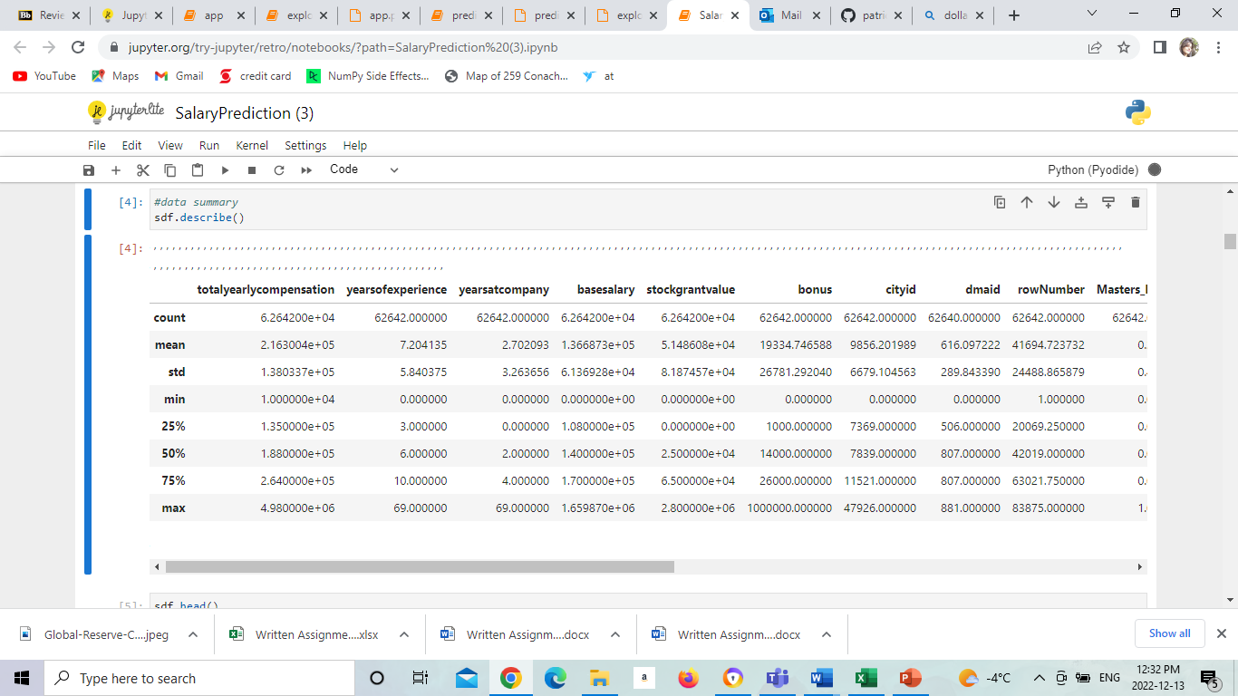

Slide 5
Models used for analysis:-
Decision Tree
Linear Regression Model
Random Forest
Grid Search

Slide 6
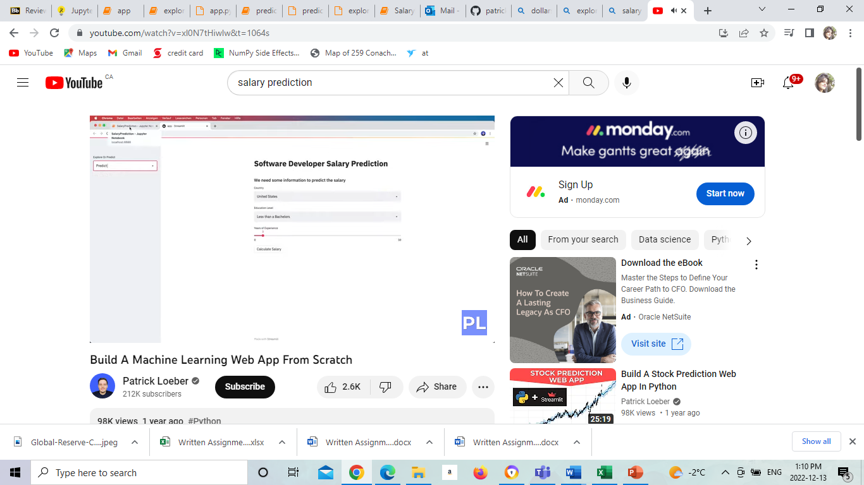
Visualizations:

Slide 7
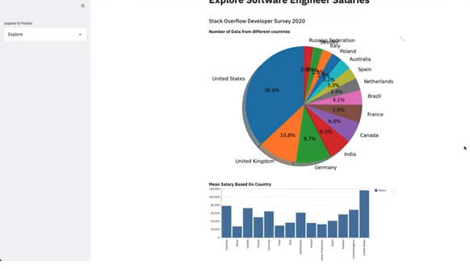

Slide 8
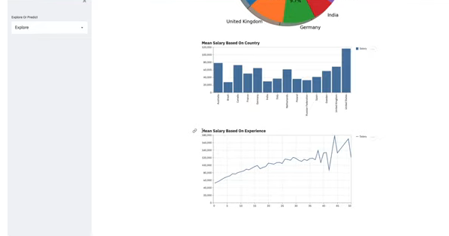

Slide 9
Benefits of this model:
Easy to use
Can predict upon not just one but different aspects
Saves time
Can be useful for students or anyone who is looking for a career switch
Useful for market analysts.

Slide 10
Thank You!

